Slide 1

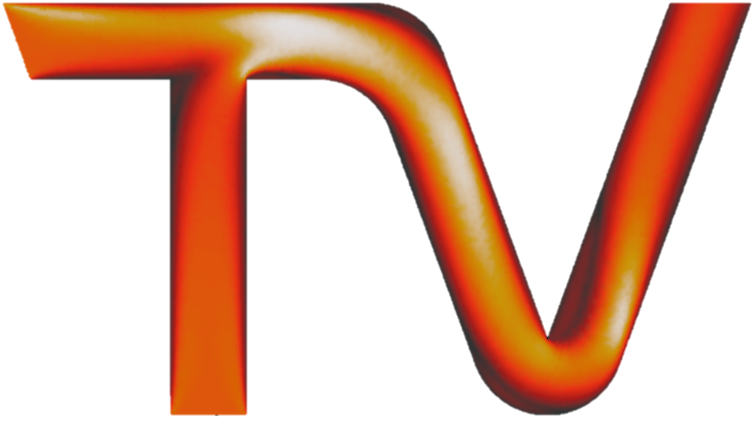
Fluidic Thrust Vectoring Design and Simulation
CFD Project / AAD 2023
Notes:
Till slide
Everyone introduces themselves
Welcome to our presentation

Slide 2
01
Fluidic Thrust Vectoring
1
Notes:
We will start by giving an introduction to fluidic thrust vectoring.

Slide 3
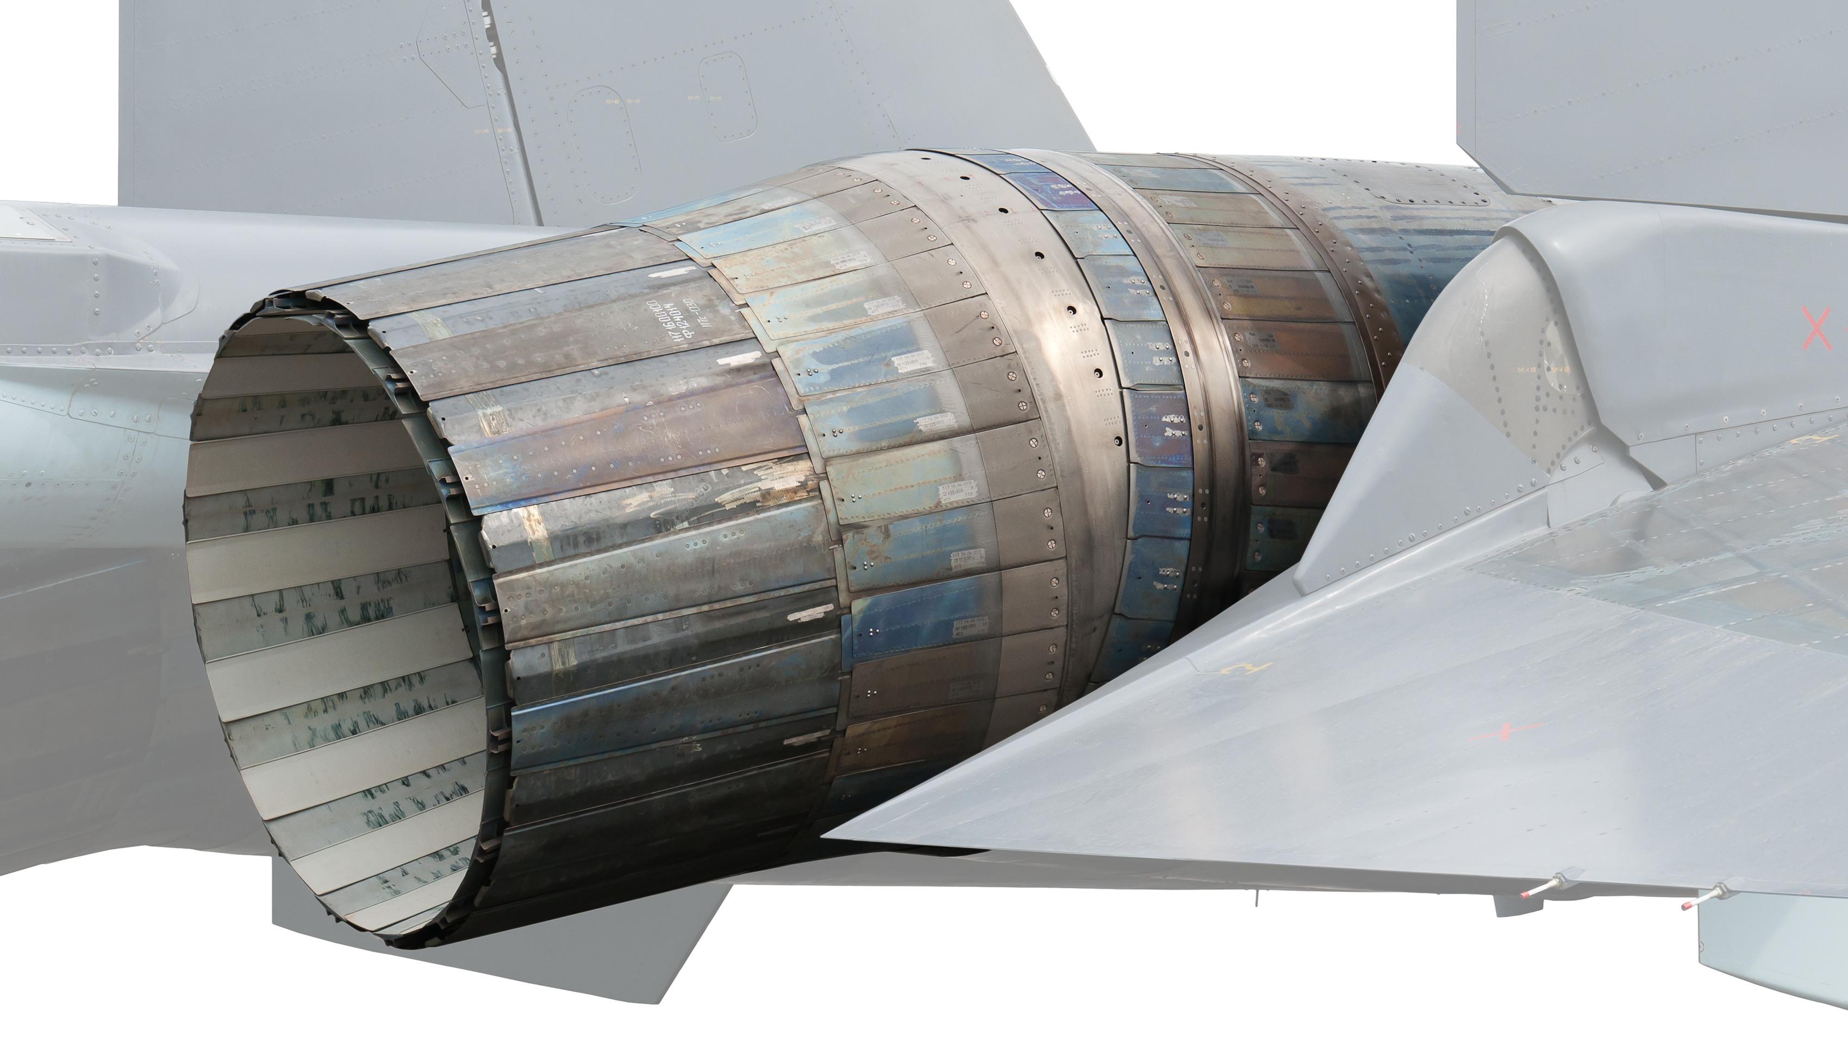
Introduction into Thrust Vectoring
Manipulation of the direction of the thrust from the engine
Increases agility, maneu-verability and survivability
Goal to maximize the vectoring of the thrust
Fluidic thrust Vectoring (FTV) requires no heavy, complex mechanical hardware
Ref: 20030058950.pdf (nasa.gov)
2
Notes:
Tulip
Thrust vectoring is important bc
In fighter aircraft,
Goal
FTV is useful bc

Slide 4
New Surrounding Requirements
Surrounding Mach Number | 1.8
Airspeed | 576.71 m/s
Altitude | 5,000 m
Gravitational Constant | 9.79 m/s2
Density | 0.7364 kg/m3
Temperature | 255.53 K
Pressure | 0.5405 Bar
Dynamic Viscosity | 1.63E-05 Pa/s
Ref: U.S. Standard Atmosphere vs. Altitude (engineeringtoolbox.com)
3
Notes:
Tulip
These are our new surrounding requirements.
The blue items are our requirements from the paper, while the white are what we conclude.
According to the document, we had to change how we ran off our free stream inlet to ensure we hit the target Mach number of 1.8. then we had to calculate the air viscosity and other parameters to ensure that we met the altitude requirement.
(This was done by modifying the air viscosity, the temperature of the free stream air and the pressure of the surrounding environment.)

Slide 5
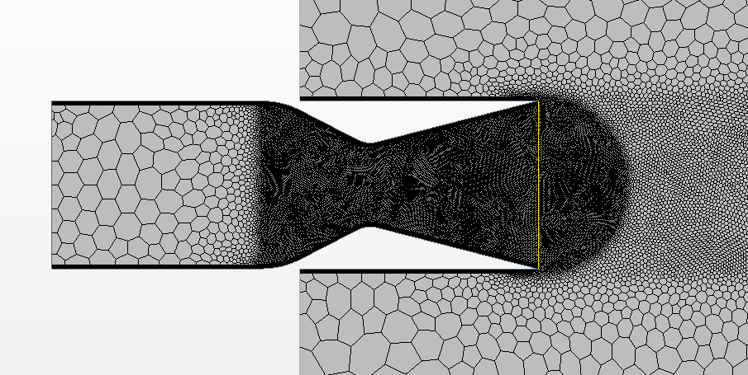
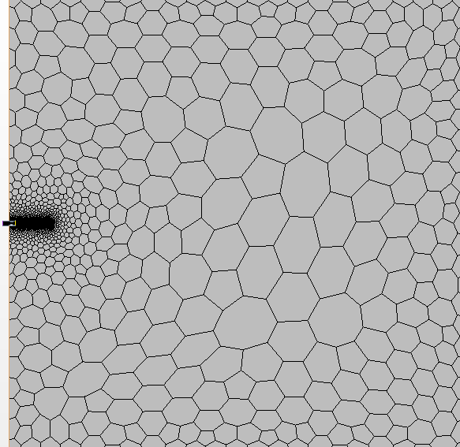
New Boundary Conditions for Surrounding Requirement
Symmetry
Walls
Stagnation Inlet
Free Stream
Pressure Outlet
Velocity Inlet
3
1. Free Stream BC instead of Velocity Inlet
2. Shorter and Straight No Slip Walls
Symmetry
4
Notes:
Till
We used our previous geometry to start our initial design process for this model. Firstly, we reported our stagnation inlets and velocity and all the other boundary conditions, including the total volume of our wind tunnel, because we know those working in our previous simulation. We then had to modify our nozzle geometry according to the previous section.
Boundary Conditions:
-Outlet is a normal Pressure Outlet with no special Condition; the upper and Lower Boundary of the Fluid Domain is Symmetry Planes, and No Slip Wall is a normal Wall
-We changed our velocity inlet to a free stream boundary inlet so that we could specify the Mach number higher than 1.
When we zoom in, you can see that we have changed to shorter and straight no-slip walls. No shock produce by the wall bc we have high Mach Number.
This is what our final bc look like.
Initial Conditions: Atmospheric Pressure to 1bar (Simulation is more stable) and Reference Pressure to 0 (Important for measuring the absoute Pressure not the relative Pressure)
The Imprint Area to the Windtunnel is a Free Flow on both sides so no Boundary Layer is created and normal Flow is Possible

Slide 6
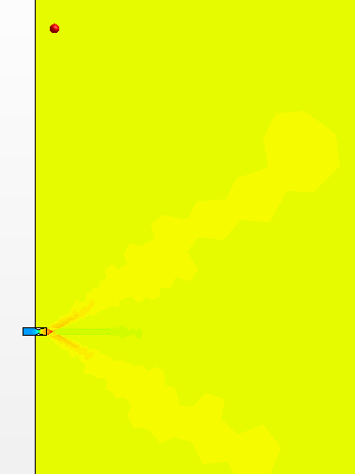
Final Air Properties Measurement
Variable | Requirement | Measurement
Surrounding Mach Number | 1.8 | 1.8
Airspeed | 576.71 m/s | 576.92 m/s
Altitude | 5,000 m
Gravitational Constant | 9.79 m/s2 | 9.79 m/s2 (Model)
Density | 0.7364 kg/m3 | 0.73642 kg/m3
Temperature | 255.53 K | 255.53 K
Pressure | 0.5405 Bar | 0.5401 Bar
Dynamic Viscosity | 1.63E-05 Pa/s | 1.63E-05 Pa/s
5
Notes:
Till
Results of final air properties measurements
Measurement point far, not effect

Slide 7
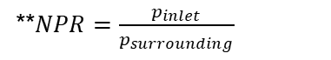
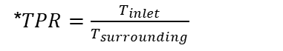
New Nozzle Requirements
Nozzle Exit Mach Number; Me | 2.2
Nozzle Exit Airspeed | 796.15 m/s
Temperature Pressure Ratio; TPR* | 2.5
Stagnation Inlet Temperature | 638.83 K
Nozzle Pressure Ratio; NPR** | 5
Stagnation Inlet Pressure | 2.7 Bar
Axial Thrust | 10,000 N
*$TPR=\frac{T_{inlet}}{T_{surrounding}}$
**$NPR=\frac{p_{inlet}}{p_{surrounding}}$
6
Notes:
Yubo
We also got New Requirements for our Nozzle (, and therefore we had to design a new nozzle)
According to the document, we had to change the nozzle design to ensure we hit the nozzle exit Mach number of 2.2, TPR of 2.5, NPR of 5, and Axial Thrust of 10000N. Then we had to calculate the nozzle exit airspeed, stagnation inlet temperature, and pressure meeting the requirements.
NPR is P inlet over P surrounding, it plays an important role in our project.

Slide 8
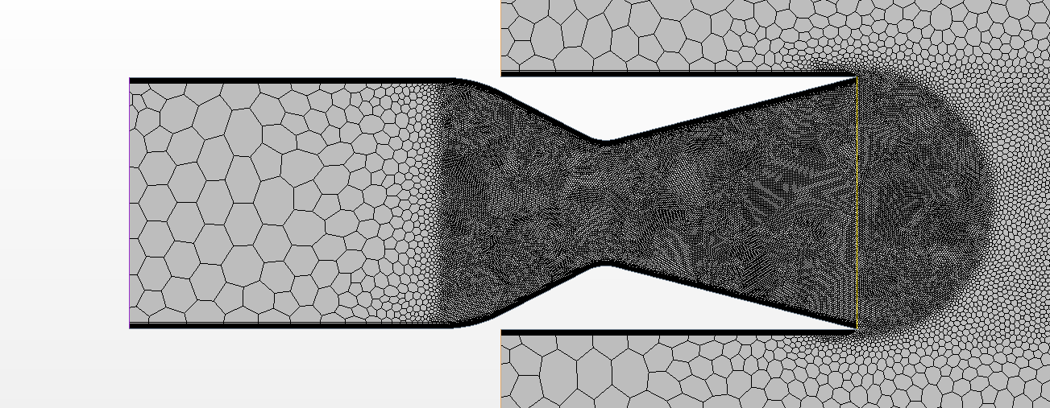


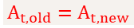
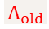
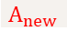
Nozzle Design
*Picture not to Scale
$${A_{t,old}=A}_{t,new}$$
$$A_{old}$$
$$A_{new}$$
$$\frac{A}{A_{t}}=\frac{1}{M}{\left[\frac{2}{γ+1}\left(1+\frac{γ−1}{2}M^{2}\right)\right]}^{\frac{γ+1}{2(γ−1)}}$$
∴ Higher $\frac{A}{A_{t}}$ → Higher Exit Mach Number
7
Notes:
Yubo
To meet the requirement of mach number, this function make an connection between the ratio of the area and the Mach number. A higher ratio means the higher exit mach number we can hit. Becaues the expected Mach number is about 2,2, we can know the expected ratio. The red part is what we changed to hit the ratio.
Keeping the same throat area and nozzle geometry, all we had to do was increase our nozzle thrust.
Nozzle longer >> A/At Ratio higher >> exit Mach number higher
(stretch)
Turn up stagnation inlet

Slide 9



Nozzle Design
*Picture not to Scale
$$New Nozzle Wall$$
$$Old Nozzle Wall$$
$$F=\text{ṁ} V_{e}+A_{e}\left(P_{e}−P_{i}\right)$$
∴ Higher$\text{ṁ}$ → Higher Thrust
8
Notes:
Yubo
To meet the requirement of the thrust, this function shows how to calculate the thrust. Because the velocity, area of the exit, and pressures were already constants, so the higher mass flow rate, the higher thrust. So in order to increase our thrust, we had to increase the mass flow rate. by scaling up the size of our nozzle, we were able to increase the mass flow rate. The yellow part is the original nozzle and the red part is what we changed. This image is not to scale.
Increase size of nozzle >> higher mass flow rate >> higher thrust (than 10k bc we don’t know how thrust vectoring effect thrust)

Slide 10


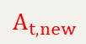
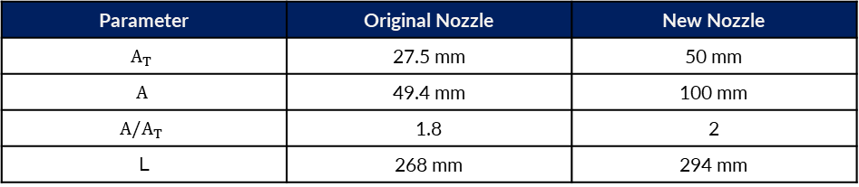
Final Nozzle Dimensions
$$A_{t,new}$$
$$A_{new}$$
$$L_{new}$$
Parameter | Original Nozzle | New Nozzle
$$A_{T}$$ | 27.5 mm | 50 mm
$$A$$ | 49.4 mm | 100 mm
$${A/A}_{T}$$ | 1.8 | 2
L | 268 mm | 294 mm
9
Notes:
Yubo
These are the final dimensions of our nozzle, compared with the original nozzle we made in part 1 of the project. You can see our new nozzle is significantly larger than the previous one.
Here some parameters are as the table shows, we change the ratio between outlet and throat, make it going to 2, and we change the size, make everything bigger.

Slide 11
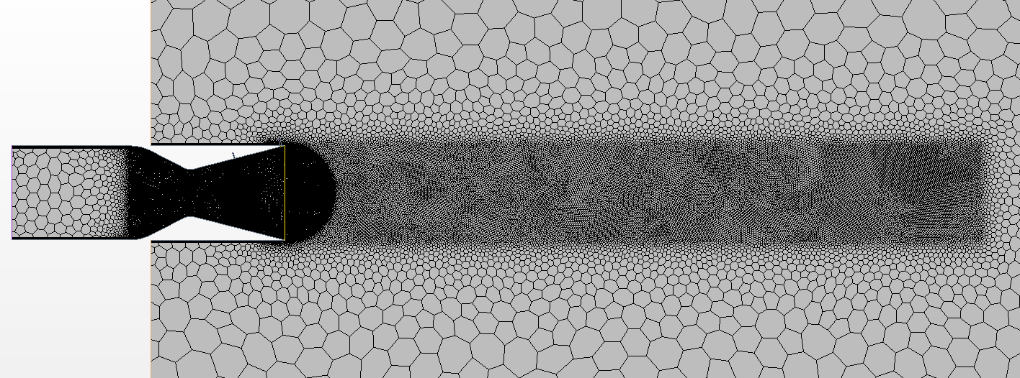
Polygonal Meshes
Mesh Area | Base Size
Farfield | 0.015 m
Plume | 0.00225 m
Nozzle Throat | 0.00075 m
10
Notes:
Tom
We relied on our previous work to design our mesh, using the same base size and refinement areas. This keeps the plume far from the edges of our simulation, ensuring that there are no strange interactions between them. As our entire model was done parametrically in starccm+, one interesting feature is that if a change was made in the nozzle geometry, the refinement areas would automatically resize to speed up our nozzle development process.

Slide 12
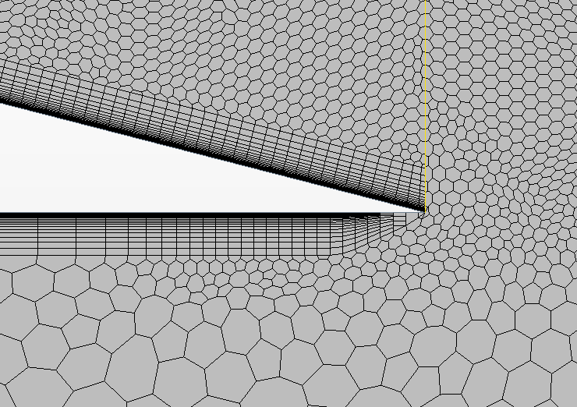
Boundary Layer Meshes
Mesh Area | Thickness | Number of Layers | Growth Rate
Farfield | 0.0025 m | 40 | 1.2
Nozzle | 0.0025 m | 40 | 1.2
Spalart-Allmaras
11
Notes:
Tom
Each area of our simulation, the nozzle, windtunnel area, and slots had different meshers. This was important to ensure that our nozzle exit area’s boundary layer did not taper off, as can be seen in the green picture. This keeps our wall y+ below 1, as is required by spellart armas turbulence modeling, and was especially important when testing slots right next to our nozzle’s exit.

Slide 13
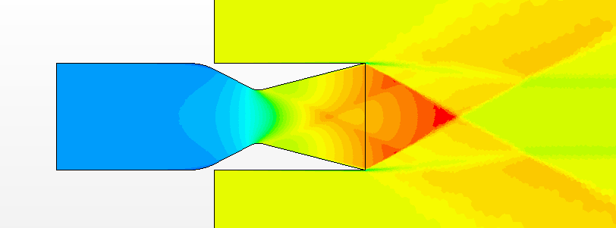
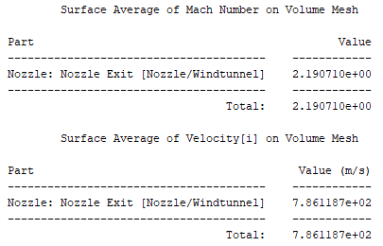
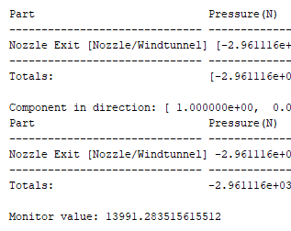
Final Nozzle Properties Measurement
Variable | Requirement | Measurement
Nozzle Exit Mach Number; Me | 2.2 | 2.19
Nozzle Exit Airspeed | 796.15 m/s | 786.12 m/s
Temperature Pressure Ratio; TPR | 2.5
Stagnation Inlet Temperature | 638.83 K | 638.83 K
Nozzle Pressure Ratio; NPR | 5
Stagnation Inlet Pressure | 2.7 Bar | 2.7 bar
Axial Thrust | 10,000 N | 13,991 N
12
Notes:
Tom
Axial thrust. Beginner much higher bc we didnt how it effect 2nd flow

Slide 14
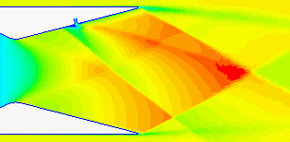
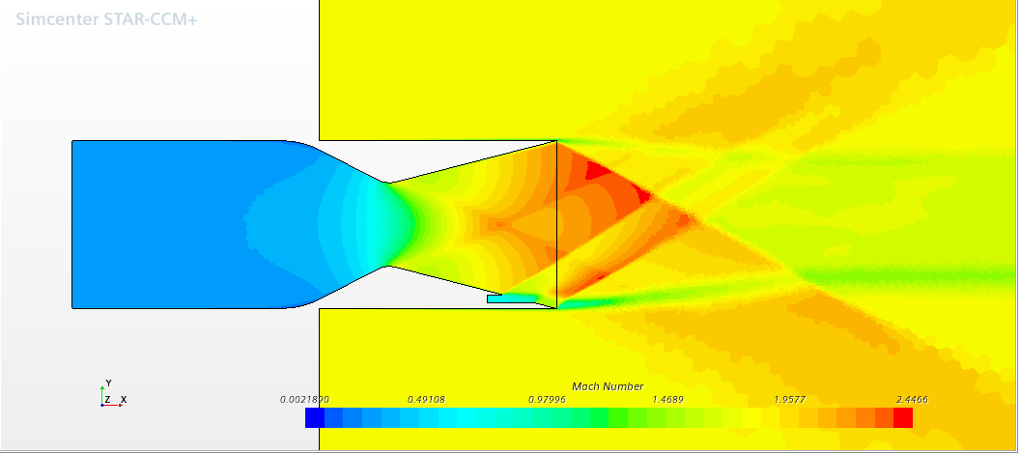
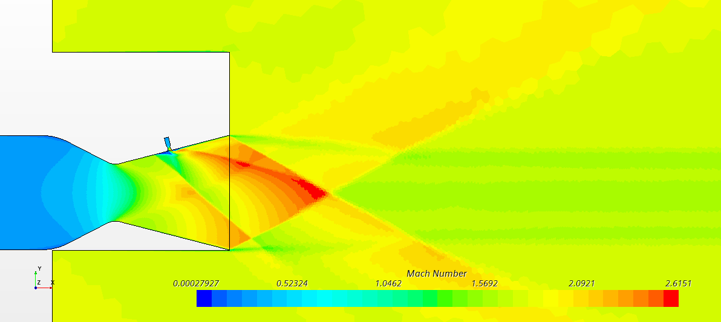
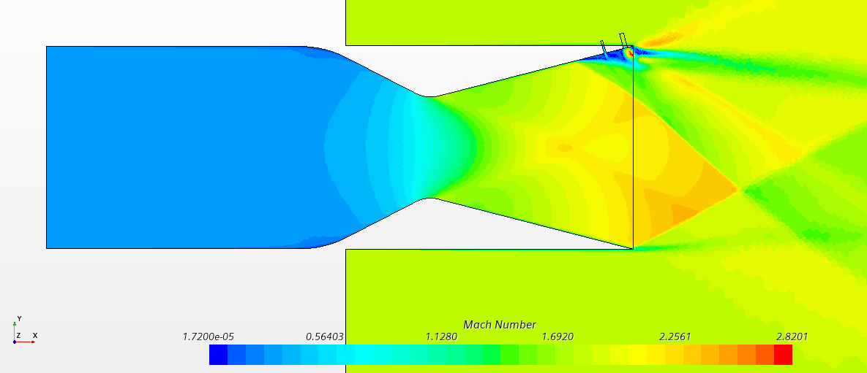
Thrust Vectoring Methods
Single Slot
Coflow
Nozzle Slot
Double Slot
13
Notes:
Tulip
Now we will show you 4 different methods we try to maximize our capacity, which are Single slot, Nozzle slot, Coflow, and Double Slot.

Slide 15
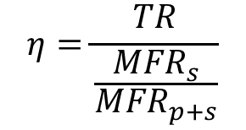
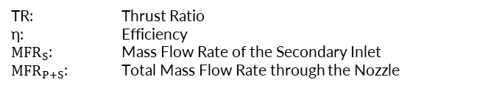
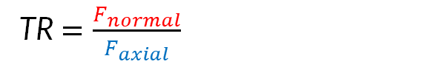
Evaluation of Results
Primary Flow Deviation
TR$=\frac{F_{normal}}{F_{axial}}$
Efficiency Calculation
$$η=\frac{TR}{\frac{{MFR}_{s}}{{MFR}_{p+s}}}$$
TR: Thrust Ratio
η: Efficiency
${MFR}_{S}$: Mass Flow Rate of the Secondary Inlet
${MFR}_{P+S}$: Total Mass Flow Rate through the Nozzle
14
Notes:
Tulip
These are how we determine the efficacy of our thrust vectoring system
The thrust ratio determines the amount of thrust being redirected downwards in our system.
Our efficiency calculation uses the Mass flow rate of our primary and secondary flows to determine how practical this system would be.
We don‘t want to use too much of the air in a jet, for example, just to give it an insignificant amount of vectored thrust.

Slide 16
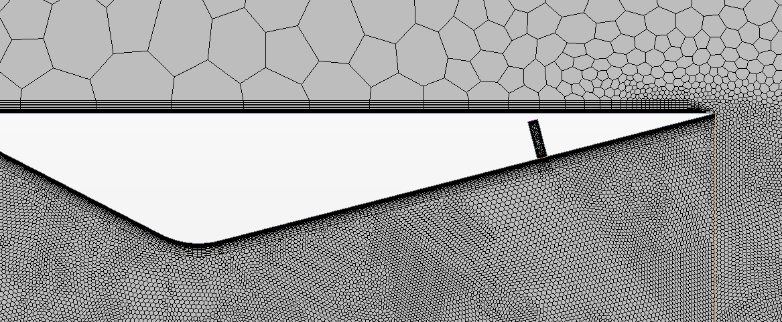
Single Slot
15
Notes:
Tulip
Because it is the most simple method for Thrust Vectoring, we started with just one Slot.
To optimize this Method, we moved the Position of the Slot from the very Inside (almost at the Throat of the Nozzle) to the Outside of the Nozzle.
You can observe that the Thrust Vectoring Efficiency increases when we move the slot further downstream.
Further downstream (outside) of the nozzle, the air stream is at a lower Pressure and has a lower density. Therefore it is easier for the secondary air stream to push through the mainstream and create a higher normal force -> Thrust vectoring Increases.

Slide 17
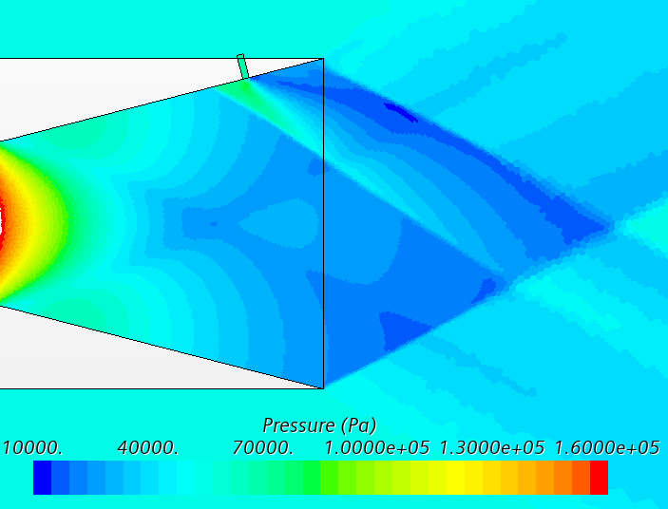
Single Slot
15
Notes:
Tulip
Because it is the most simple method for Thrust Vectoring, we started with just one Slot.
To optimize this Method, we moved the Position of the Slot from the very Inside (almost at the Throat of the Nozzle) to the Outside of the Nozzle.
You can observe, that the Thrust Vectoring Efficiency gets higher, when we move the slot further dowstream.
Further downstream (outside) of the nozzle, the air stream is at a lower Pressure and has a lower density. Therefore it is easier for the secondary air stream to push through the main stream and create a higher normal force -> Thrust vectoring Increases

Slide 18
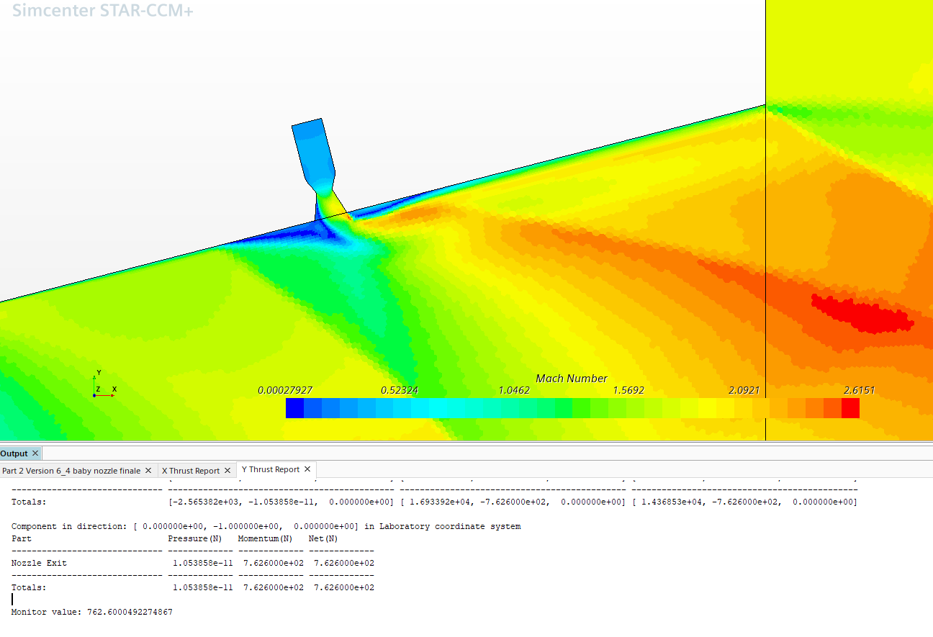
Nozzle Slot
Slots at 0.241 m | Slot Mass Flow Rate | Thrust Ratio | Efficiency
Rectangular Slot | 0.861 | 0.07 | 177.87%
Nozzle Slot* | 0.864 | 0.05 | 137.51%
*Nozzle dimensions were scaled from the main nozzle
16
Notes:
Tom
Next, we thought it may be adventagous to switch from a rectangular slot to a nozzle outlet. Keeping the same positioning and mass flow rate, our Efficiency was lower and the thrust ratio also decreased relative to the previous rectangular slot. We are not certain why this happens, but believe it is because the expanding part of our slot allows air from the nozzle exit area into the expanding part of the nozzle slot. This mixing happens within the small nozzle instead of the large one, leading to a smaller boundary layer seperation, and thus a smaller shockwave. Perhaps with the correct nozzle slot design, this solution would be better than a rectangular slot, but our data indicates that the simpler solution performs better.

Slide 19
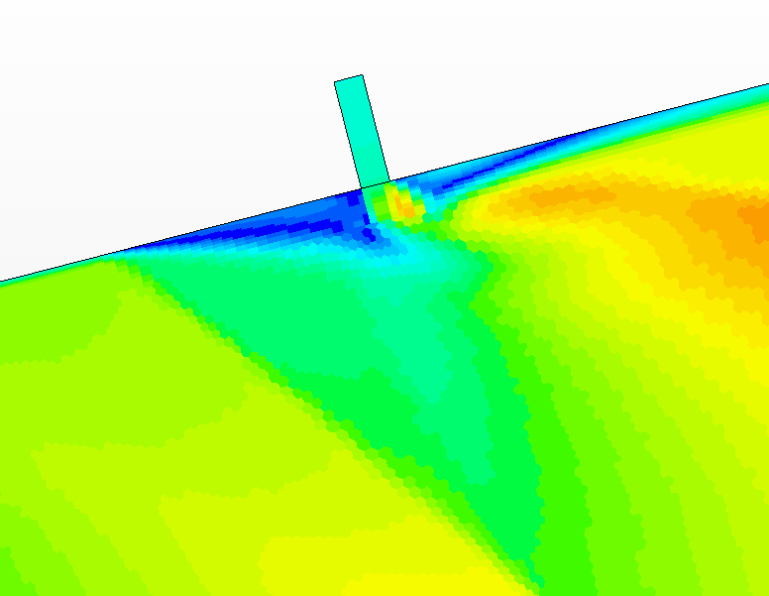
Nozzle Slot
Slots at 0.241 m | Slot Mass Flow Rate | Thrust Ratio | Efficiency
Small Nozzle* | 0.4362 | 0.03 | 173.89%
Large Nozzle* | 0.864** | 0.05 | 137.51%
*Nozzle dimensions were scaled from the main nozzle **Same mass flow rate as best rectangular slot, this is worse at both
16
Notes:
Tom
Next, we thought it may be adventagous to switch from a rectangular slot to a nozzle outlet. Keeping the same positioning and mass flow rate, our Efficiency was lower and the thrust ratio also decreased relative to the previous rectangular slot. We are not certain why this happens, but believe it is because the expanding part of our slot allows air from the nozzle exit area into the expanding part of the nozzle slot. This mixing happens within the small nozzle instead of the large one, leading to a smaller boundary layer seperation, and thus a smaller shockwave. Perhaps with the correct nozzle slot design, this solution would be better than a rectangular slot, but our data indicates that the simpler solution performs better.

Slide 20
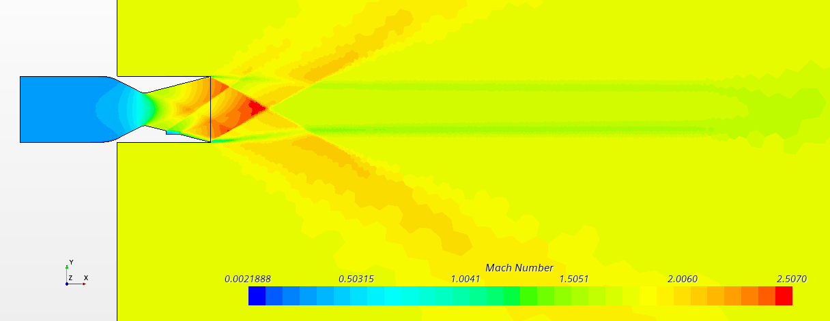
Coflow Thrust Vectoring
Parameter | Value
Secondary Mass Flow Rate | 0.5113 kg/s
Resulting Thrust Ratio | 0.035
Nozzle Efficiency | 149.13%
17
Notes:
Yubo
This inspires by what we say, Coflow, which refers to a flow in which two or more fluids move together in the same direction, help creates a vortex in the fluid and improving the overall efficiency of the nozzle.
The results are as follows.
In terms of parameters, when the pressure of the secondary inlet is small, the secondary mass flow rate is small, which is fine; but the normal thrust is also so small. As the secondary pressure increases, both parameters increase, and the best efficiency is when the secondary pressure is 1 bar; the value is about 150%. This was our highest efficiency and thrust ratio solution out of 11 different designs and secondary pressures.
2nd scheme is in the same direction
kind of the slot more contributing to the axial thrust

Slide 21
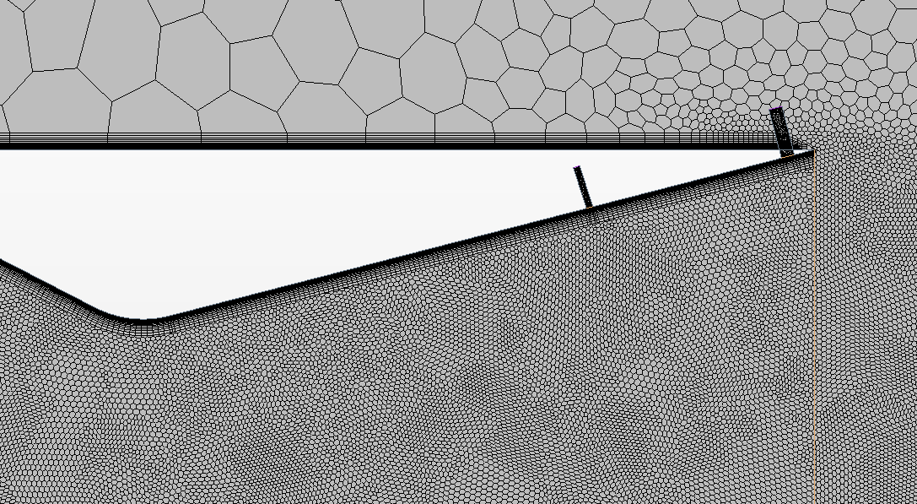
Double Slot
18
Notes:
Till

Slide 22
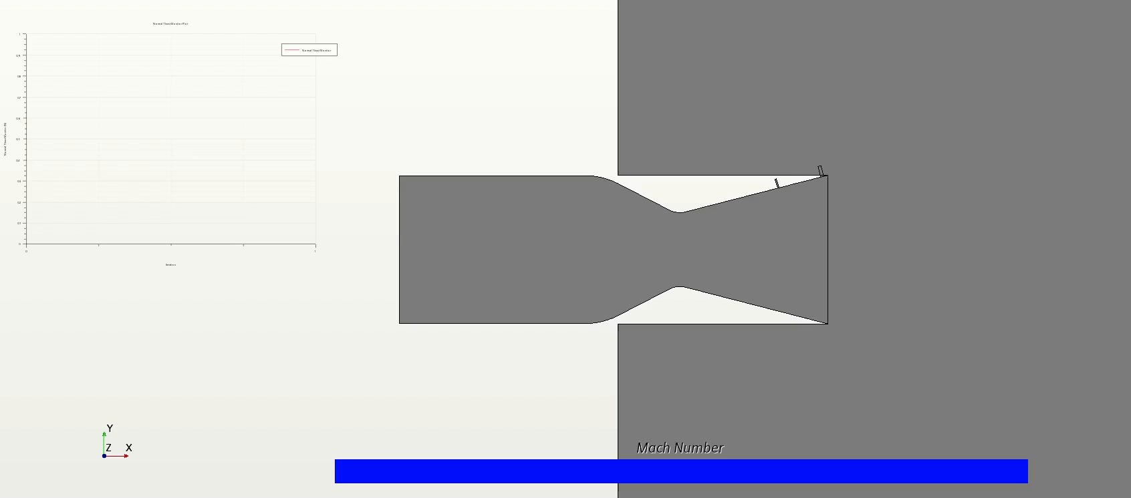
Normal Thrust Plot
19
Notes:
Till

Slide 23
20
Notes:
Till
In the same efficiency, the thrust ratio of two slots is higher than one slot.

Slide 24
02
Intercultural Reflection
21
Notes:
/Tulip/

Slide 25

Intercultural Environment
22
Notes:
/Tulip/ As we are a team from different countries, Thailand, China, America, and German, working in an intercultural environment can be both exciting and challenging. At first, we have no idea where to begin. We started by talking and dividing roles so everyone had a specific task to do. However, we don’t stick too much because we figure out naturally who is fit for certain tasks, such as organization, theory, research, and detail. (45sec)
/Yubo/ Another challenge is overcoming language barriers, especially when dealing with diverse cultures. For example, when I have ideas, am confused, or have problems with the paper, I struggle to describe things, especially in technical terms. And also using the software is also a challenge for me, because it is my first time not to calculate but to do it by hand or on the computer. It is also an English software which is also a challenge.
/Tommy/
We found great way to work with each other and work towards our strengths. I am more of a software guy, so I focused a lot on helping other members with that and making our models. I, however, am not as detail oriented as tulip, or as curious as till, or have as much theoretical background as yubo. We each found our lanes that could contribute the most to the project, which I feel led to all of us having a great experience!
/Till/ Summary: Looking back at this Project, I think we are all happy that it is over, but also happy that we were a part of it. We agreed that we all profited from it in many ways and definitely learned a lot. Not only about Star CCM, Excel and Powerpoint, but also about how to use a complex software in a different language or Chinese bars and most importantly how to not kill the team leader when he wants to do 30 additional runs just so the graphs look nicer... So thank you for that guys! But honestly….we learned how to be patient and how to create a positive intercultural environment and I think we managed to all look at each other as amazing individuals and friends whether than other nationalities. We are all very proud what we achieved as this team and this…no one can take from us.
Thank you!
(Language barriers can hinder effective communication, lead to misunderstandings, and impact productivity and collaboration. Linked with Gudykust’s theory, language barriers can increase anxiety levels due to uncertainty and fear of making mistakes.)

Slide 26
03
Questions and Answer
23
Notes:
/Tulip/

